Slide 1
Robotics, digitalization, workplace automation: What future for manufacturing in Hungary?
Andrea Szalavetz
Third bilateral Polish-Hungarian Conference
Warsaw, 29th September, 2016

Slide 2
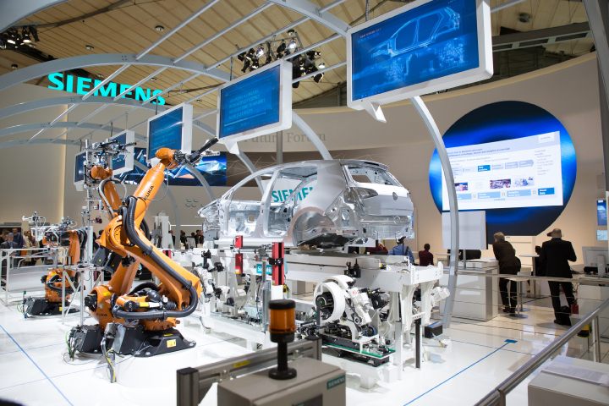
Motivation: contribute to the debate about the impact of new technologies

Slide 3
Reshoring to advanced economies?

Slide 4
Investigation methods
Conceptual analysis based on overview of science and engineering and business literature on the attributes of individual technologies
e.g. Journal of Mechanical, Industrial Science and Engineering; IFAC Papers, CIRP Annals-Manufacturing Technology; CIRP Journal of Manufacturing Technology; Robotics and Computer-Integrated Manufacturing; Virtual and Augmented reality applications in manufacturing – Springer; etc.
Interviews with MNC subsidiaries and research institutions specialised in industry 4.0 solutions
8+2 interviews

Slide 5
What does the literature tell us?
Evolutionary view of economic change
(Nelson and Winter, 1982)
Technological change induces selection, retention and reconfiguration mechanisms → also within GVCs!
New manufacturing technologies → GVC orchestrators make strategic locational decisions
Keep and upgrade existing manufacturing facilities through installing industry 4.0 technologies (retention);
Consolidate and concentrate manufacturing activities in a (couple of) specific location(s) (selection);
Backshore part of the activities, establish new facilities, and/or outsource certain tasks (reconfiguration)

Slide 6
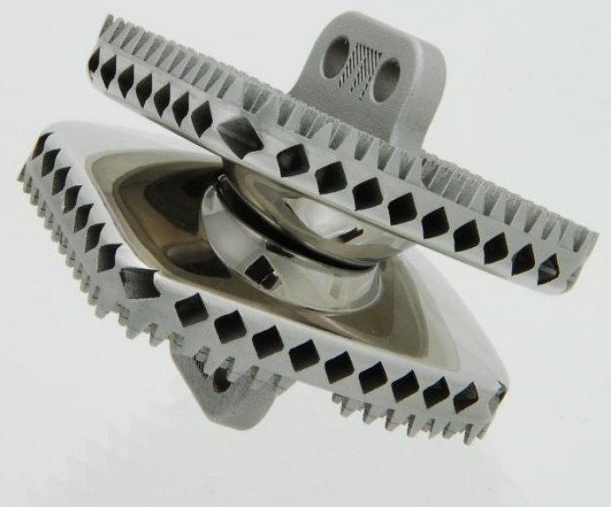
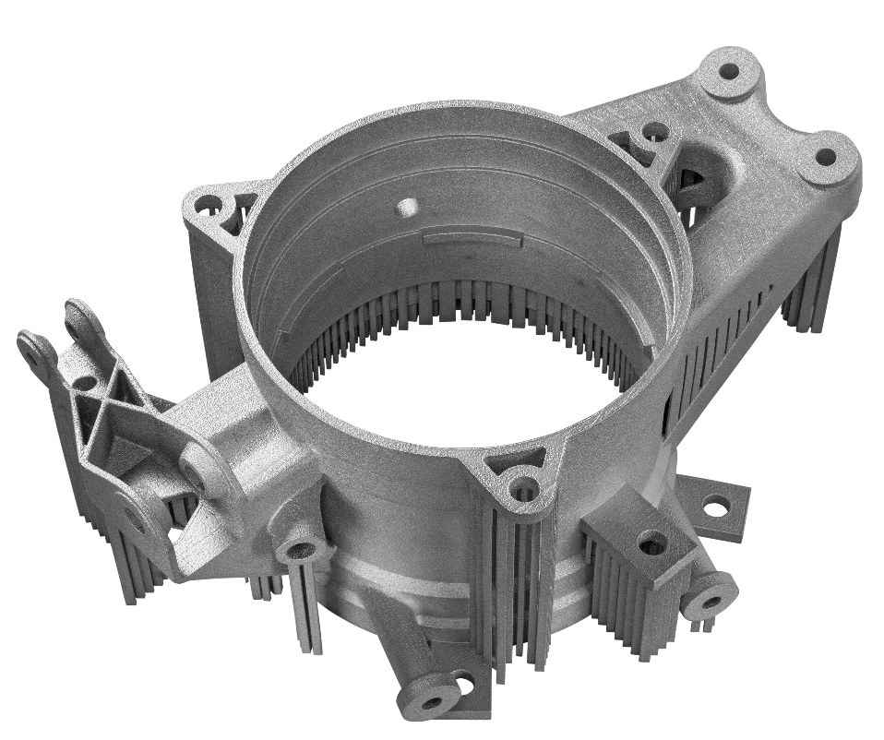
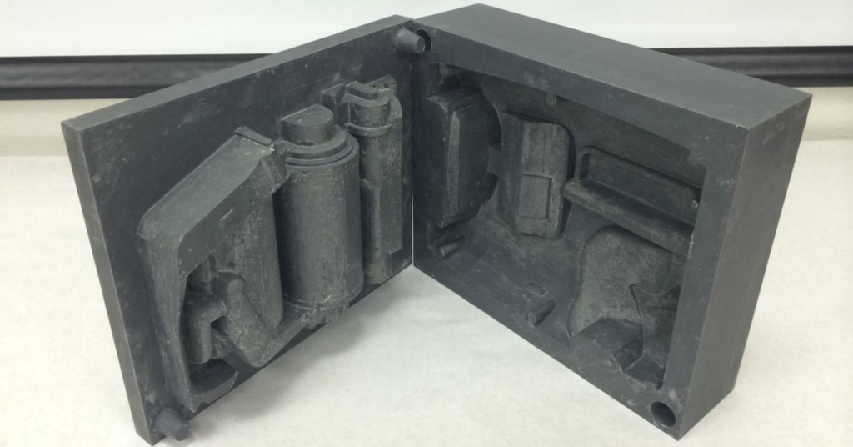
Conceptual analysis: 3D Printing & tooling

Slide 7
Virtual reality powered collaborative engineering

Slide 8
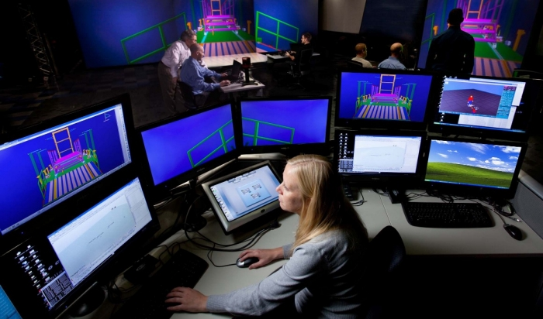

Slide 9
Digitalisation of local engineers’ work: takeover or redefinition of their tasks
layout planning and process configuration; production planning and scheduling; investigation of the machinability of new product designs; process development ↔ big data, smart algorithms, simulations, modelling, automated production scheduling

Slide 10
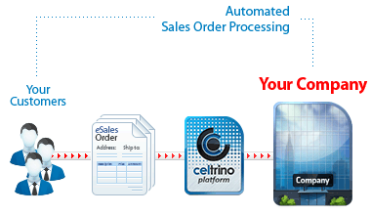
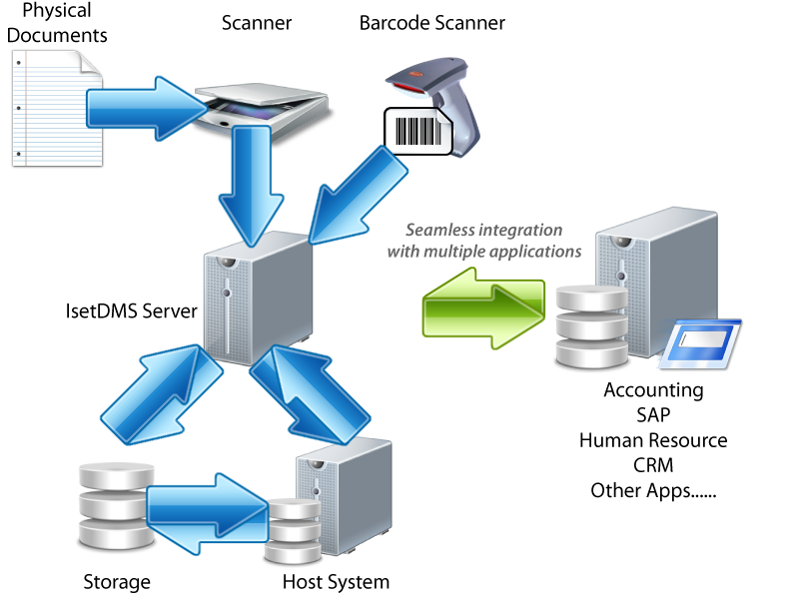
Automation of knowledge work performed in local shared services centres
Artificial intelligence → accounting, order processing, payroll management, operational procurement, CRM

Slide 11
Not only T from SWOT → also O
Compatibility with legacy systems
The deployment, operation and maintenance of advanced manufacturing solutions require substantial development of subsidiary-level engineering capabilities

Slide 12
Interview results
Industry 4.0. → Gradual, evolutionary journey
Local showcases of ‘factory of the future’ → MNCs apply global corporate standards
Why did MNCs invest?
Factory economy: digitising the shop-floor (making factories smart) is easier than transition to platform competition, entry in new industries, business model innovation, innovative digital services provision
Purpose: solution of specific challenges: shop-floor technological problems, overview of complex processes, customer requirements, + quest for operational excellence + !! labour shortage !!

Slide 13
Interview results (cont.)
Instead of relocating / reshoring production, (so far) MNC owners have upgraded their existing production facilities
Job losses BUT demand has grown for both skilled operators and highly skilled engineers
Instead of reshoring (centralising) knowledge-intensive activities MNC owners would like to assign additional knowledge work to their subsidiaries → e.g. programming of industrial robots; process development, experimental analysis, measurement and testing, modelling and simulation of manufacturing processes
Labour shortage!!

Slide 14
Policy implication
Immediate action is needed to reform factory economies’ education system
Delays may eventually hinder technology adoption, and will indeed lead to the relocation of activities !
Conclusion: it is not technological progress per se that hits factory economies: it is the rigidity of their labour market and of their education system that makes them a loser of the digital transformation of manufacturing!

