Slide 1
Third Polish – Hungarian Bilateral Conference
„Development pattern of CEE countries after the 2007-2009 crisis on the example of Poland and Hungary”
Warsaw, 29 September 2016 (Palac Staszica)

Slide 2
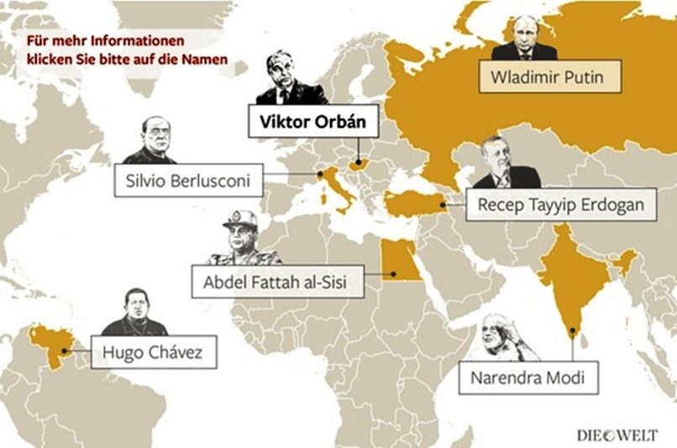
Peter MIHALYI
Renationalization and Recentralization in Hungary, 2010 - 2016

Slide 3
Overview
Hungary was a pioneer of the post-communist transition process until cca. 2001.
The motivations of the 2nd and the 3rd Orbán government.
The most important nationalization transactions.
The size and the impact of the renationalization campaign.

Slide 4
1.

Slide 5
International globalization index, 2010

Slide 6
The cumulative size of privatization revenues in some Central and Eastern European countries (as a % of GDP)
Source: OECD.

Slide 7
The stock of foreign direct investments (FDI) in some Central and East European countries on a per capita basis, 2007

Slide 8
Degree of liberalization in the energy sector in 2008
Source: OECD

Slide 9
Market liberalization indices on 0-6 scale (2013)
Source: OECD

Slide 10
2.

Slide 11
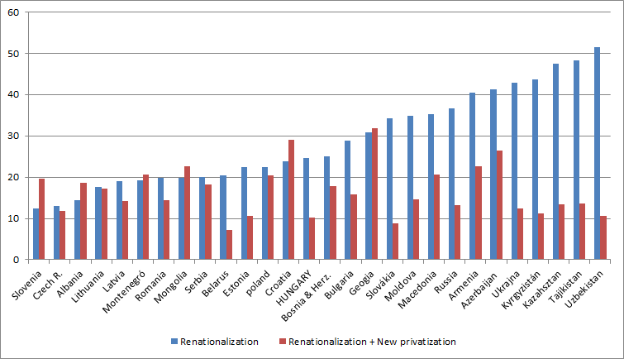
„Everybody hates privatization” (EBRD 2006)
Question: „In your opinion, what should be done with most privatized companies? They should be…”

Slide 12
Renationalization: Time and geographic dimensions
In Hungary prior to 2010: Failed privatization deals followed by repurchase of shares, then by privatization again. ← Occasional, non-systematic.
Occasional East European cases:
  Serbia (1994) – law on the reprivatization of 436 firms
  Meciar (1995) took back a natural gas distribution and a telecommunication company
  Albania (2009) electricity distribution company
  Bulgaria (2014) with the slogan of „reindustrialization”
Drastic renationalizations in the former USSR:
  Russia starting with Yeltsin’s rule after 1998, then followed by Putin.
  Ukraine: Kyvorizhstal (2004) renationalization, then re-sale justified by corruption charges.
  Kyrgyzstan: Jeruy goldmine (2006)
  Estonian railways (2007)

Slide 13
The political story, 1990 - 2015
1990 – 1994: Center-right, three-party coalition government (not much privatization in the strategic sectors)
1994 – 1998: Socialist-liberal coalition (path breaking, major privatization deals in the utility and banking sectors)
1998 – 2002: 1st government of Victor ORBÁN, center-right coalition (not much privatization in the strategic sectors)
2002 – 2006, 2006- 2010: Socialist-liberal coalition (not much privatization in the strategic sectors)
2010 – 2014: 2nd govt. of Victor ORBÁN, center-right (drastic renationalizations in the utility sector)
2014 - ? : 3rd govt. of Victor ORBÁN, right-wing (lot of talk, but so-far not a single major new transaction has been implemented)

Slide 14
The half-secret co-operation of the political left and the political right – starting from 1994 and even more strongly after 1998 in the energy sector
Gradual renationalizations and the re-building of the vertically integrated national electricity company (MVM).
Keeping government influence on MOL, the national hydrocarbon (oil + gas) company [the largest Hungarian firm!!!] which was de jure and de facto privatized through IPOs as from 1995.
Blocking the completion of utility privatization in the capital city of Budapest (gas, water, waste water).
Ad hoc price control measures for household energy items, especially prior to elections.

Slide 15
Overall policy environment in 2010 - 2016
Autocratic, one-person rule, strengthened by a new constitution and a set of fundamental laws, requiring 2/3 majority in Parliament.
Centralization of public ownership in the hand of the government and at the detriment of local governments (e.g. education, health, culture, disaster relief).
Anti-liberal legislation (e.g. price control, laws with retroactive effect, shift from direct towards indirect taxes, new punitive taxes).
Limiting the fusion and anti-cartel legislation.
Direct control over the majority of the largest municipalities.
Deep skepticism towards Western Europe (EU, euro, immigration).
Strong anti-US rhetoric (= anti-liberal rhetoric).
Continuous confrontation with Hungary’s neighbors because the alleged „unfair treatment” of Hungarian minorities (chiefly Romania and Ukraine).

Slide 16
Who is the buyer?
The Hungarian National Asset Management Inc. (MNV Zrt.)
The national electricity company, 100% owned by MNV Zrt.
The Hungarian Development Bank, 100% owned by the Hungarian state.
The capital city of Budapest and some other major towns.
The National Bank of Hungary.
Unknown private individuals, close to the ruling party.

Slide 17
Free commercial/business activities limited by the declaration of state monopoly
The so-called cafeteria system: meal tickets and holiday tickets used for paying tourism services
Possession and use of passenger cars with foreign license plate
Construction of new shopping malls for 2 ½ years
Mobil payment systems (e.g. car parking)
In waste collection private ownership was maximized at 49%.
The market for company liquidation service was closed
The operation of gambling machines in catering units
The operation of DNA forensic laboratories
The involvement of private engineering firms in the design of EU-financed state investment projects.
Higher entry conditions for language teaching schools

Slide 18
3.

Slide 19
Major renationalization deals after 2010
The 2nd Pillar of the pension system = 100% privately owned, pension cooperatives, with an accumulated wealth (≈ 10% of GDP)
  Mostly government debt instruments
  Company shares + cash
22% of Mol from a Russian private company for cash (≈ € 1.9 bn)
The network of the Hungarian cooperative banks (128 independent financial institutions + a jointly owned „central” bank), a German- and an American-owned bank, 15% ownership in an Austrian bank. Transit re-nationalization??
Gas storages, pipe lines and the rights of the Hungarian – Russian gas import contract from E.ON (Germany) (€ 0.9 bn).
A vertically integrated bauxite-alumina business (MAL) after a serious industrial accident (through liquidation, no payment)
Rába Automotiv Holding Plc. – through delisting from the Budapest Stock Exchange
Mahart Passnave – shipping company providing services on the Danube only.
Hungarian Foreign Trade Bank (in the Autumn of 2014)

Slide 20
Major renationalization deals after 2010 (cont.)
Budapest Waterworks from Lyonnaise des Eaux – RWE Aqua GmbH consortium
10) Antenna Hungaria telecommunication company, the main broadcaster of Earth-based tv and radio channels – from TDF Price: 180 M €.
11) Termination of PPP contracts (planned only for contracts amounting to 10% of GDP, very few transactions happened)
12) Remondis waste collecting company, AVE waste collecting company
13) Three provincial meat-processing companies.
14) Giro, the national interbank payment settlement proving company, previously owned by the largest banks

Slide 21
Miscellaneous
Major school textbook publishing company
Ferencváros football club
Catering company serving the national railway company on passenger trains
The network of tobacco retail trade – a reduction of sales points from 42 thousand to 6 thousand.

Slide 22
Publicly announced, but not implemented major renationalization deals
MÁV national railways company’s privatized freight cargo subsidiary,
Dunaferr steel complex – owned by Russian investors
Budapest Ferihegy Airport – privatized through a concession deal
An Austrian commercial bank (Raifeissen)
Budapest Sewage Works Ltd. - currently owned by Berliner Wasser Betriebe (B.W.B.) and Compagnie Générale des Eaux (C.G.E.)
Omninvest – the largest vaccine manufacturer owned by private Hungarian investors

Slide 23
Legally speaking, nothing was expropriated
Lucrative offers
Predatory behavior, forced sales
Introduction of (new) licenses, cancelling the old ones
Hostile takeovers
Corporate raiding (reyderstvo)

Slide 24
Forms of renationalization
 | Examples
Purchase of equity
--- at going market price | 22% of MOL, Ferencváros Football Club
--- at distressed price
--- achieved by price control and/or new punitive taxation rules | Public utilities, gas storage facilities, Hungarian Foreign Trade Bank
--- after bankruptcy | 3 slaughter houses
--- achieved by fine | Hungarian Aluminum Holding
Voluntary transfer of assets | Mandatory pension funds
Excluding the incumbents from the market (regulatory taking) | Municipal bank cooperatives, Tobacco shops, School book publishing houses, Meal tickets, etc.
Reyderstvo | Water management company of Pécs, Welt 2000 Ltd. (software company)

Slide 25
The motives of the 2nd and 3rd Orbán government in the renationalization campaign
„Changing of the Guard” based on political loyalty → Nomenclatura nationalization.
Direct control over politically relevant consumers prices (e.g. electricity, gas, water, chimney sweeping, banking fees)
Creating national capitalism and national champions.
Price control + punitive taxes → profit losses → foreign owners are „happy” to sell the company and/or quit certain segments of the market (e.g. gas distribution, retail banking).
„Sweetheart deals” with US, German, French, Austrian and Russian multinational companies.

Slide 26
Counter-facts
Sale of the last 25% of shares of Budapest Airport in 2011.
Renationalization and re-sale
  The cooperative banking sector, followed by selling it to a large Hungarian-owned mortgage bank.
  Casino nationalization and resale of the concession rights to Hungarian private owners
3) Secret „strategic agreements” with 40 foreign multinationals operating in Hungary.

Slide 27
4.

Slide 28
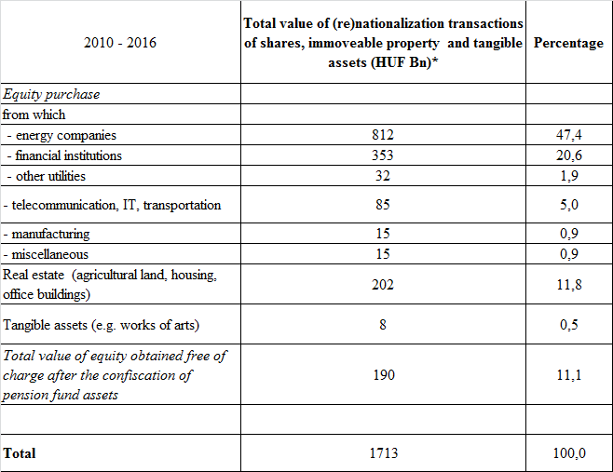
The results so far…

Slide 29
… cont.
Notes:
* All known transactions executed by public authorities, including the largest local governments.
** From which 128 are co-operative banks.
*** Including 25 thousand houses and/or apartments purchased from defaulted FX borrowers.
Cut-off date for information: 25 September, 2016.
Source: Author’s compilation of data from different official sources and daily newspapers.
*

Slide 30
a) The budgetary impact
According to the Maastricht rules, the fiscal balance should be measured on accrual basis (rather than cash basis). Thus today, the cost of nationalization doesn’t appear as a negative item, just as it happened during the heydays of privatization, when privatization revenues didn’t matter.
In accounting terms, for the state household there is merely an asset swap:
Privatization = equity (-) vs. cash (+)
Nationalization = cash (-) vs. equity (+)

Slide 31
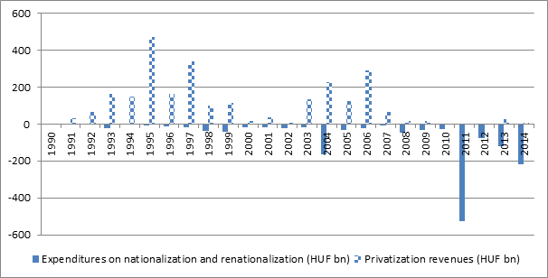
The macro-balance of privatization and renationalization, 1990 - 2014
HUF bn

Slide 32
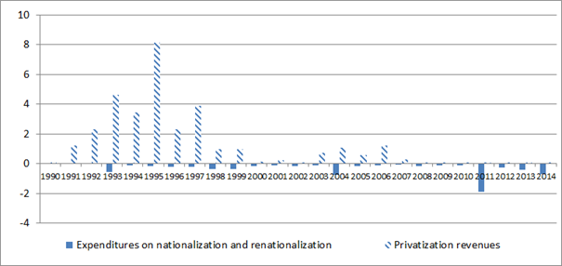
… the same, as a % of GDP
%

Slide 33
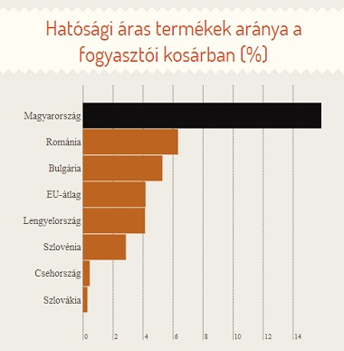
b) Regulatory impact
The share of government controlled prices for consumers (CPI-based)
Hungary
Romania
Bulgaria
EU-average
Poland
Slovenia
Czech R.
Slovakia

Slide 34

The most important dilemma: what kind of system is this?
A reconfiguration of the diverse authoritarian, racist/fascist governments which ruled Hungary country between 1921 and 1945. In this paradigm, ideology, religious and cultural power are more important than personal wealth accumulation goals.
See:
http://hungarianspectrum.org/2014/11/29/rudolf-ungvary-on-the-fascistoid-mutation-in-todays-hungary-part-i/ and
http://hungarianspectrum.org/2014/11/30/rudolf-ungvary-on-the-fascistoid-mutation-in-todays-hungary-part-ii/
for an English language summary.
Just like the Fidesz party, the state itself was placed under the control of a single individual (Mr. Orban) to enforce submission and obedience. The author characterizes the system as the ‘organized over-world’, the state employing mafia methods to enrich a small circle of privileged.

Slide 35


Slide 36

Contact coordinates:
Prof. Dr. Peter MIHÁLYI
Head
Department of Macroeconomics
Corvinus University of Budapest
and
Visiting Professor
Central European University (Budapest)
Economics Department
E-mail: peter@mihalyi.com
Editor-in-Chief of Acta Oeconomica
URL: http://akkrt.hu/22/journals/products/economics/acta_oeconomica_eng

